Slide 1
Image Tagging: Results and Analysis

Slide 2
Categories Modeled and Results
NOTE: All metrics are based on performance on test sets of 250+ images, so they should be good approximations for future performance

Slide 3
Overview
I decided to model and predict the 6 categories that in my mind would be most useful for returning relevant clothes on different searches
I purposefully favored, as well, ones that would be more difficult
Some are very ambiguous, and the multi-label aspect of some of them adds additional complexity.
Overall, I am very happy with the results

Slide 4
TAGS: Body
Body (i.e. Dress, Top, etc)
Single label data (can be either Dress or Top etc but not more than one)
Total of 5 options in the data
90% model accuracy
Use (i.e. Weekend, Day, etc)
Multi label data (can have many uses on one garment)
Total of 6 options in the data
85% F1 score, 87% precision

Slide 5
TAGS: Color
Primary Color
Single label data
Total of 14 options in the data
63% top1 accuracy, 80% top 2 accuracy
Genre (i.e. Nature, Whimsy)
Multi label data
Total of 14 options in the data
61% F1 score, 76% precision

Slide 6
TAGS: Material
Chief (i.e. Silk, Cotton, etc.)
Single label data
Total of 4 options in data
85 % accuracy
Type (i.e. Georgette, Twill)
Multi label data
Total of 9 options in data
51% F1 score, 70% precision

Slide 7
Methodology

Slide 8
Data and Preprocessing
Decided to use only image data, no text data
Robust to differences in terminology brand over brand
Makes model more applicable to a broader range of tasks besides tagging
Discussed more later
Images were downloaded from the ...fun... output given by the airtable :) and saved to a folder on Google drive
When input into neural nets, images were preprocessed with normalization and resizing. For several models, data was augmented by rotating and flipping images (where applicable)
Image tensors were loaded into a custom pytorch dataset (ImageData) so that they could be used with a pytorch data loader, which has several performance benefits

Slide 9
Model Architecture
As per the norm for image data, the general model architecture was several convolutional layers (which included batch normalization, max pooling, and ReLU activation functions) followed by linear layers again connected by ReLU activation functions
Depending on the model, architecture varied based on testing and intuition
Overfitting quickly? Add weight decay and decrease model size
Not learning the training data? Increase model breadth/depth, decrease # of convolutional layers
Loss function was either cross entropy loss or binary cross entropy with logits loss, the former for single label data and the latter for multi label data

Slide 10
Visualizations, Examples, and Additional Uses

Slide 11
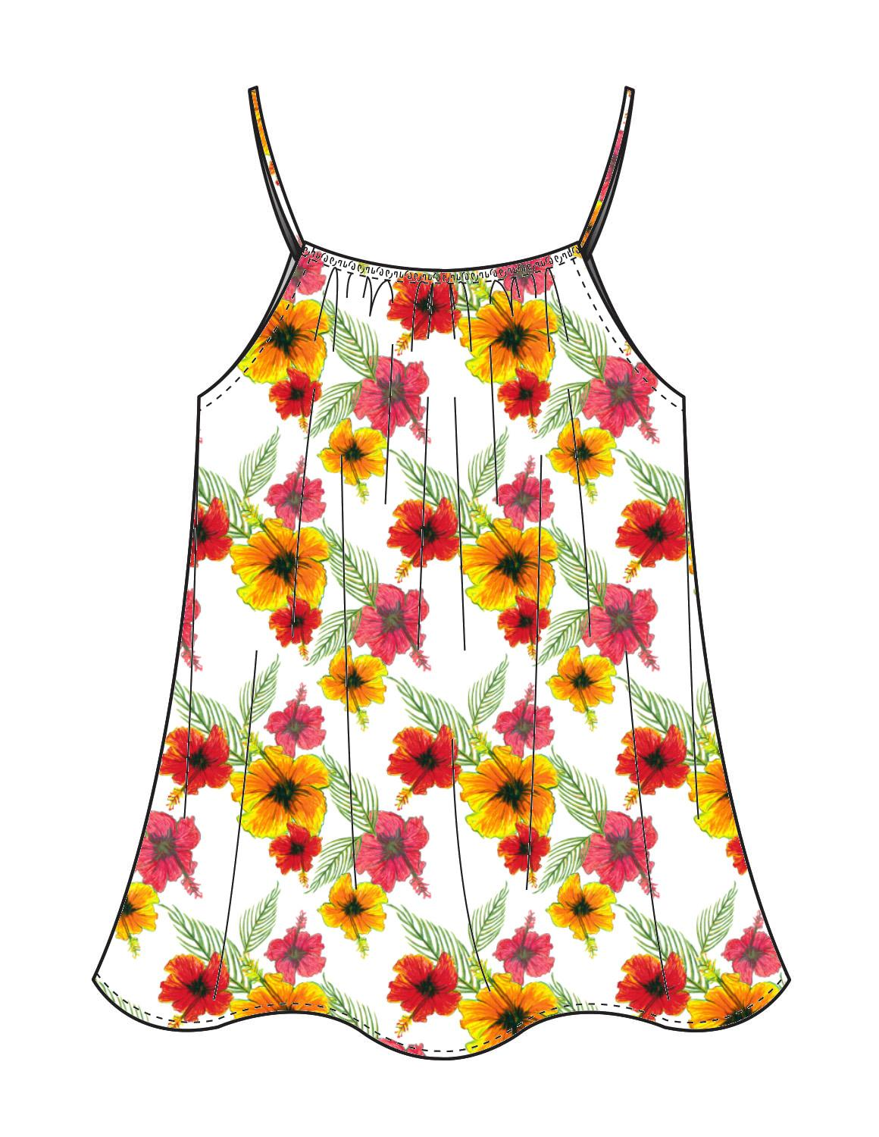
Example 1
Genre: Floral
Primary Color: White
Chief: Silk
Body: Top
Use: Day, Evening, Work, Weekend
Type: Georgette

Slide 12
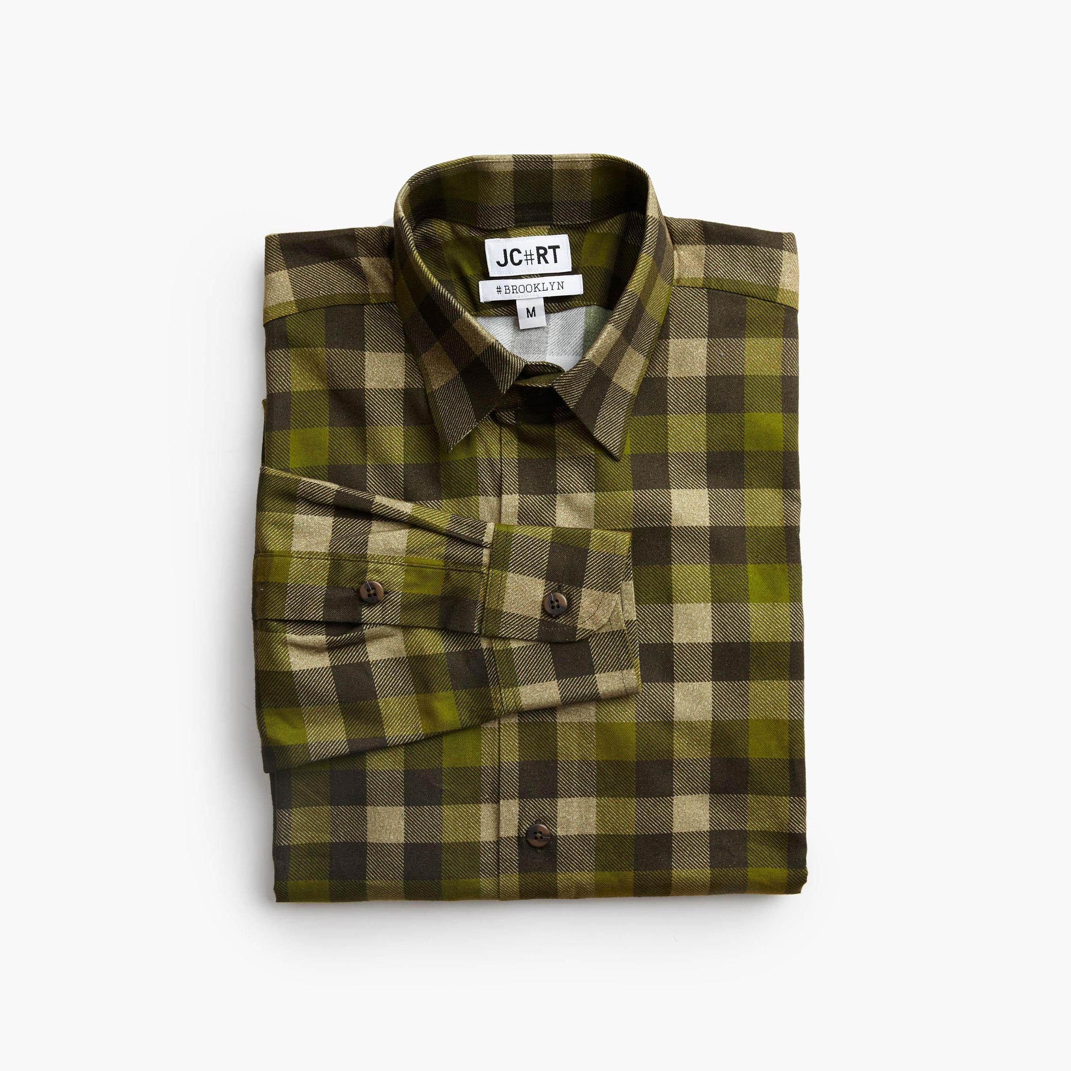
Example 2
Genre: Plaid
Primary Color: Brown
Chief: Cotton
Use: Day, Work, Weekend
Type: Plain
Note: None of the brand JR shirts had body tags so it was not feasible to make predictions for them

Slide 13
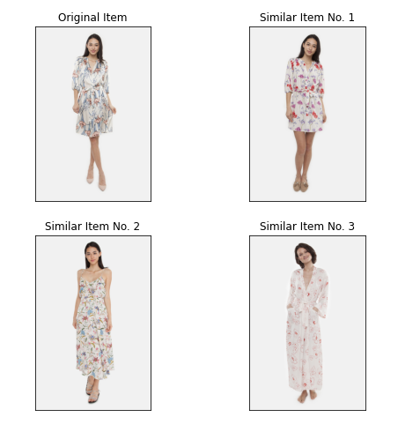
Vector Embeddings to Find Similar Items
Can use the probability outputs from the neural nets for each category as a way to embed the images into vector space
Can then calculate the distance between each vector to find the most similar images
Great results! Could be the start of “you liked this item? How about these...”

Slide 14
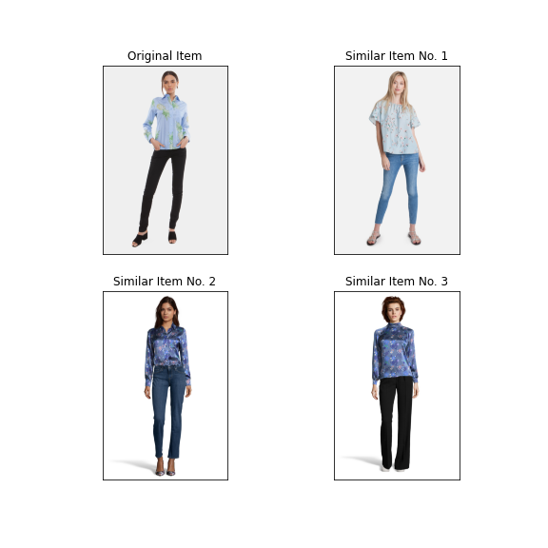
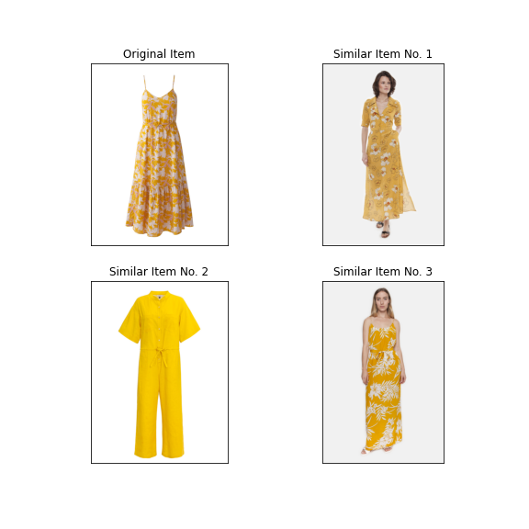
Few more examples

Slide 15
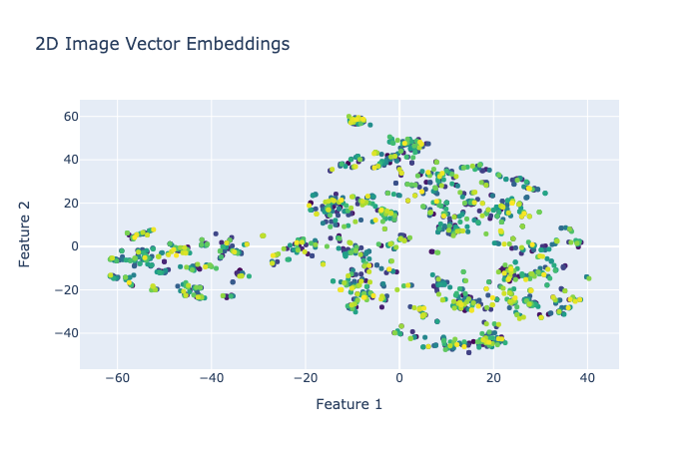
Item Groupings with Vector Embedding
See pockets of similar items, which you can then inspect further with the “similar_images” function
High dimensional data reduced to 2 dimensions with TSNE
Find Interactive Version either in the Format ipynb or in the presentation folder labeled ‘Embed.html’

Slide 16
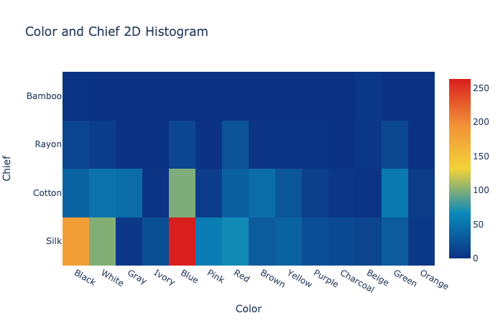
Inventory Overview with 2D Histogram
Easy snapshot of how many clothing items you have of two category types (i.e. how many blue, silk items do we have?)
Can quickly compare any two categories
Find Interactive Version either in the Format ipynb or in the presentation folder labeled ‘Hist.html’

Slide 17
Additional Uses/Next Steps
Could scrape images from competitor ads that perform well, and use the embeddings to find items of ours similar to the piece of clothing in the ad
As a whole, using these image embeddings to gather information about advertisements and trends would be an obvious next step
Could also upload an image of a potential design to “similar_images” function and see what clothing Resonance already has like it

